Slide 1
Plant Cell
www.ecosystemforkids.com

Slide 2
Plant Cell
A cell is the smallest structural and functional unit of an organism, typically microscopic and consisting of cytoplasm and a nucleus enclosed in a membrane.

Slide 3
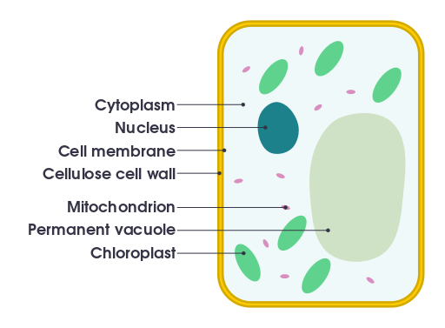
Parts Of A Cell And Their Functions
It is the jelly-like fluid that fills a cell.
It is within the cytoplasm that most cellular activities occur, such as many metabolic pathways including glycolysis, and processes such as cell division.
It stores the cell's hereditary material, or DNA, and it coordinates the cell's activities, which include intermediary metabolism, growth, protein synthesis, and reproduction.
The basic function of the cell membrane is to protect the cell from its surroundings. The cell membrane controls the movement of substances in and out of cells and organelles.
The cell wall is the protective, semi-permeable outer layer of a plant cell. A major function of the cell wall is to give the cell strength and structure, and to filter molecules that pass in and out of the cell.
The main job of mitochondria is to perform cellular respiration. This means it takes in nutrients from the cell, breaks it down, and turns it into energy.
In mature plant cells, vacuoles tend to be very large and are extremely important in providing structural support, as well as serving functions such as storage, waste disposal, protection, and growth.
Chloroplasts contain chlorophyll, a green pigment that absorbs light energy for photosynthesis.

Slide 4
www.ecosystemforkids.com
Science Activities
Online quizzes
Board games
1st Grade
PowerPoint lessons
Visit the website above
2nd Grade
Resources for teachers / students
All free and always online
3rd, 4th, 5th , 6th Grades
Free resources for teachers

